Slide 1
Advisory Report 3
Shrey Agrawal
David Dai
Hong Doan
Jiayi Chen

Slide 2

Agenda
Business Understanding Revisit
Goals Statements
Reflections
Moving Forward

Slide 3
Business Understanding Revisit
“Build A Better Grinnell” is a community-based initiative aimed at improving the quality of life in Grinnell, Iowa.
The goal is gather data from the focus population (Grinnell residents), collect innovation from the base and have a shared understanding of strengths, visions, and priorities.

Slide 4
Goals Statements - What to Expect
Combination of words (Phrases)
Look at words before and after words like “community” and “lack”
Associate categories or meaningful labels to the clusters created by various clustering algorithms
Explore other methods of clustering that may work better like PAM clustering and interpret outputs
Clean new dataset

Slide 5
Goal#1 - combination of words/phrases
Identify the phrases, such as Lack of XXX ; Small community
Look at what words are before or after, and count their frequency
We noticed the word lack appear a lot in responses of the question: “What things have frustrated you about living in Grinnell?”.
Create a list of words that appear after and before the word lack in the question, to make more contextual sense of the word lack
We noticed the word community appear a lot in responses of the question: “What are things that make you glad to live in Grinnell?”
Create a list of words that appear after and before the word community in the question, to make more contextual sense of the word community

Slide 6
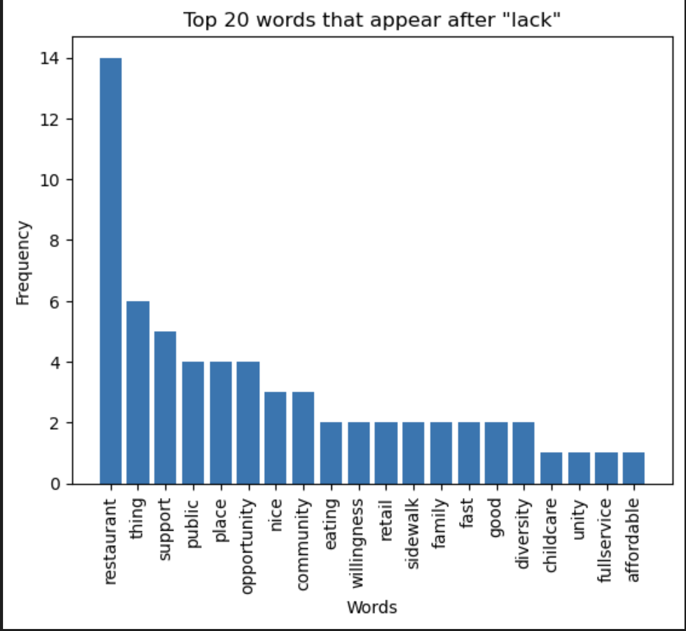

Slide 7
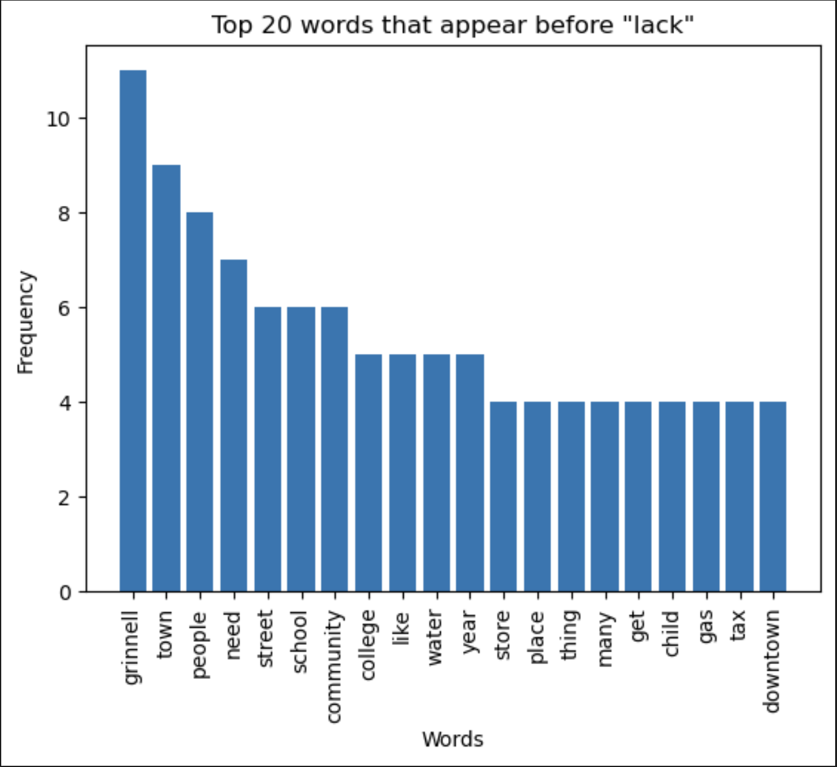

Slide 8
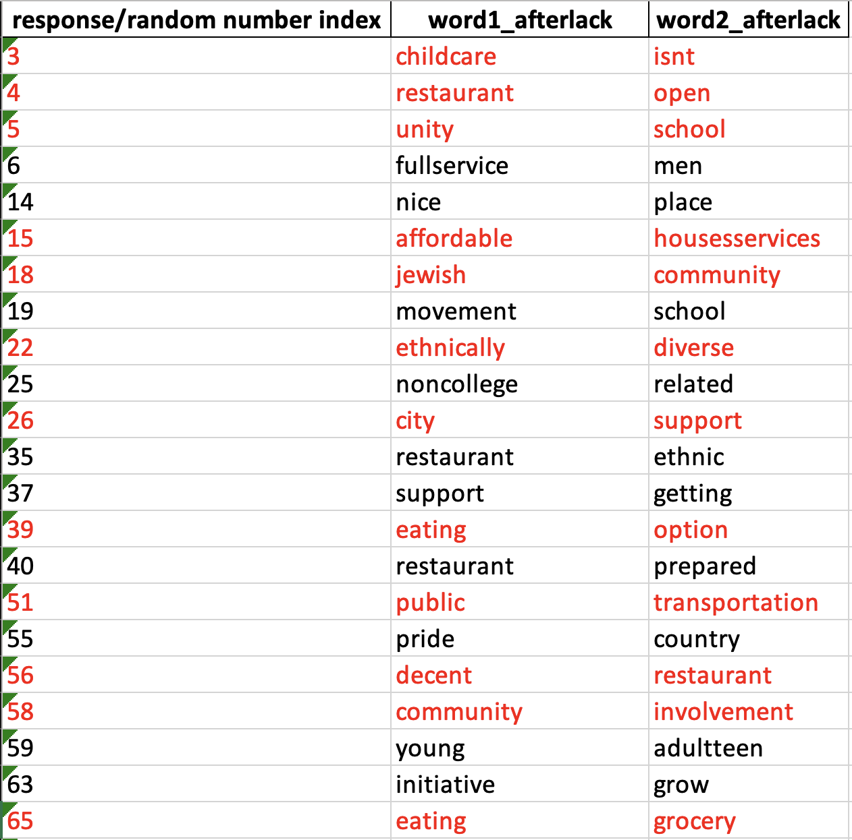

Slide 9
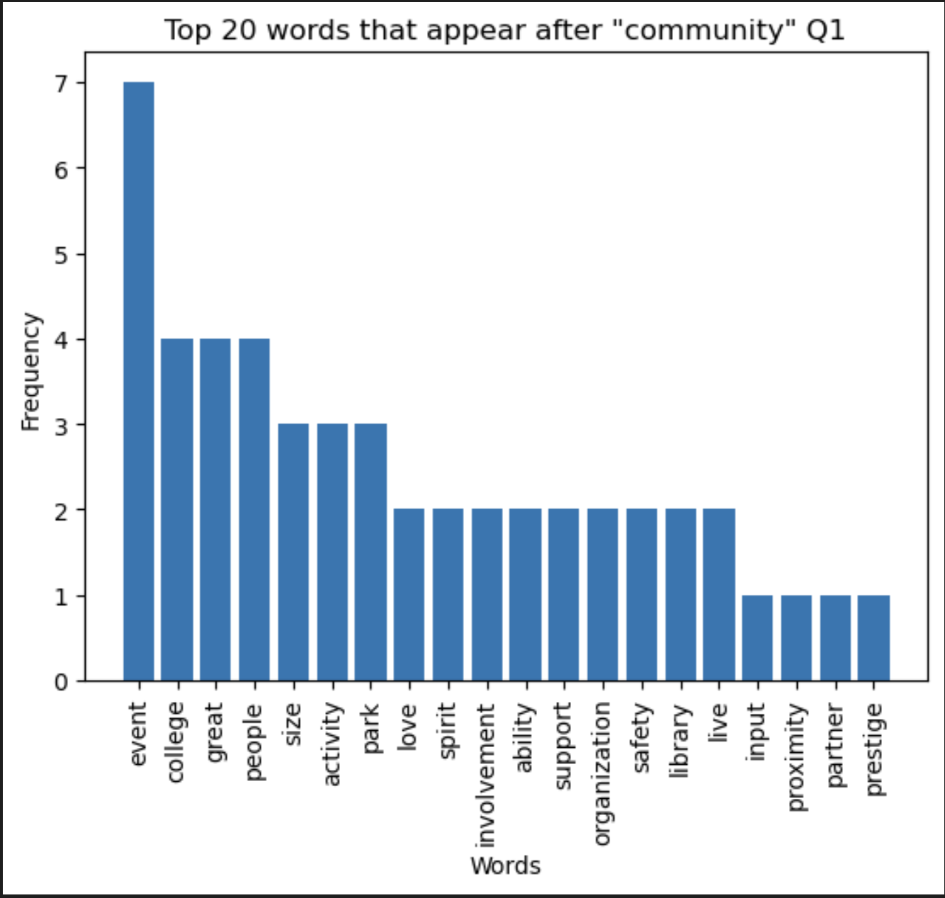

Slide 10
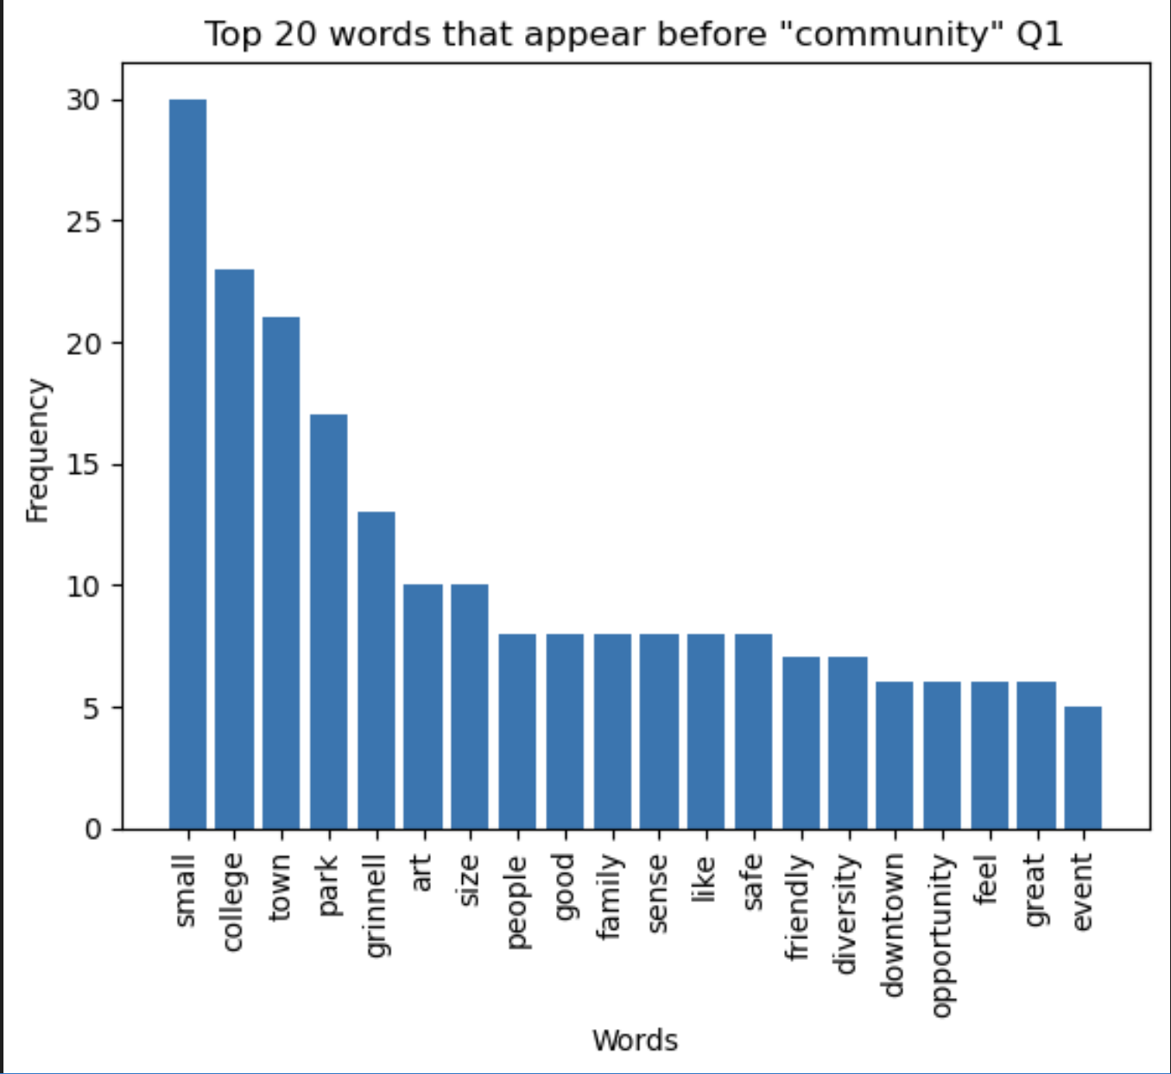

Slide 11
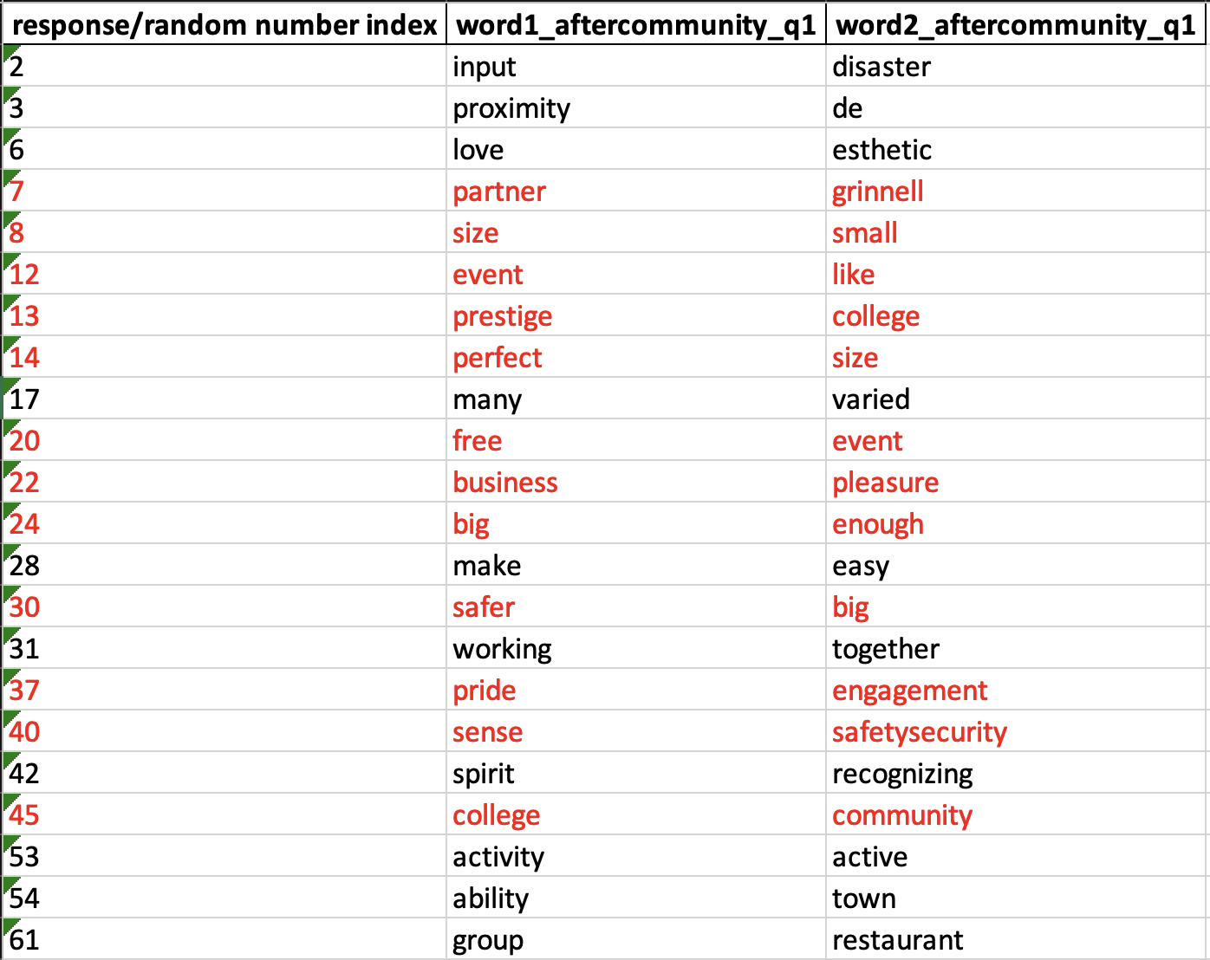

Slide 12
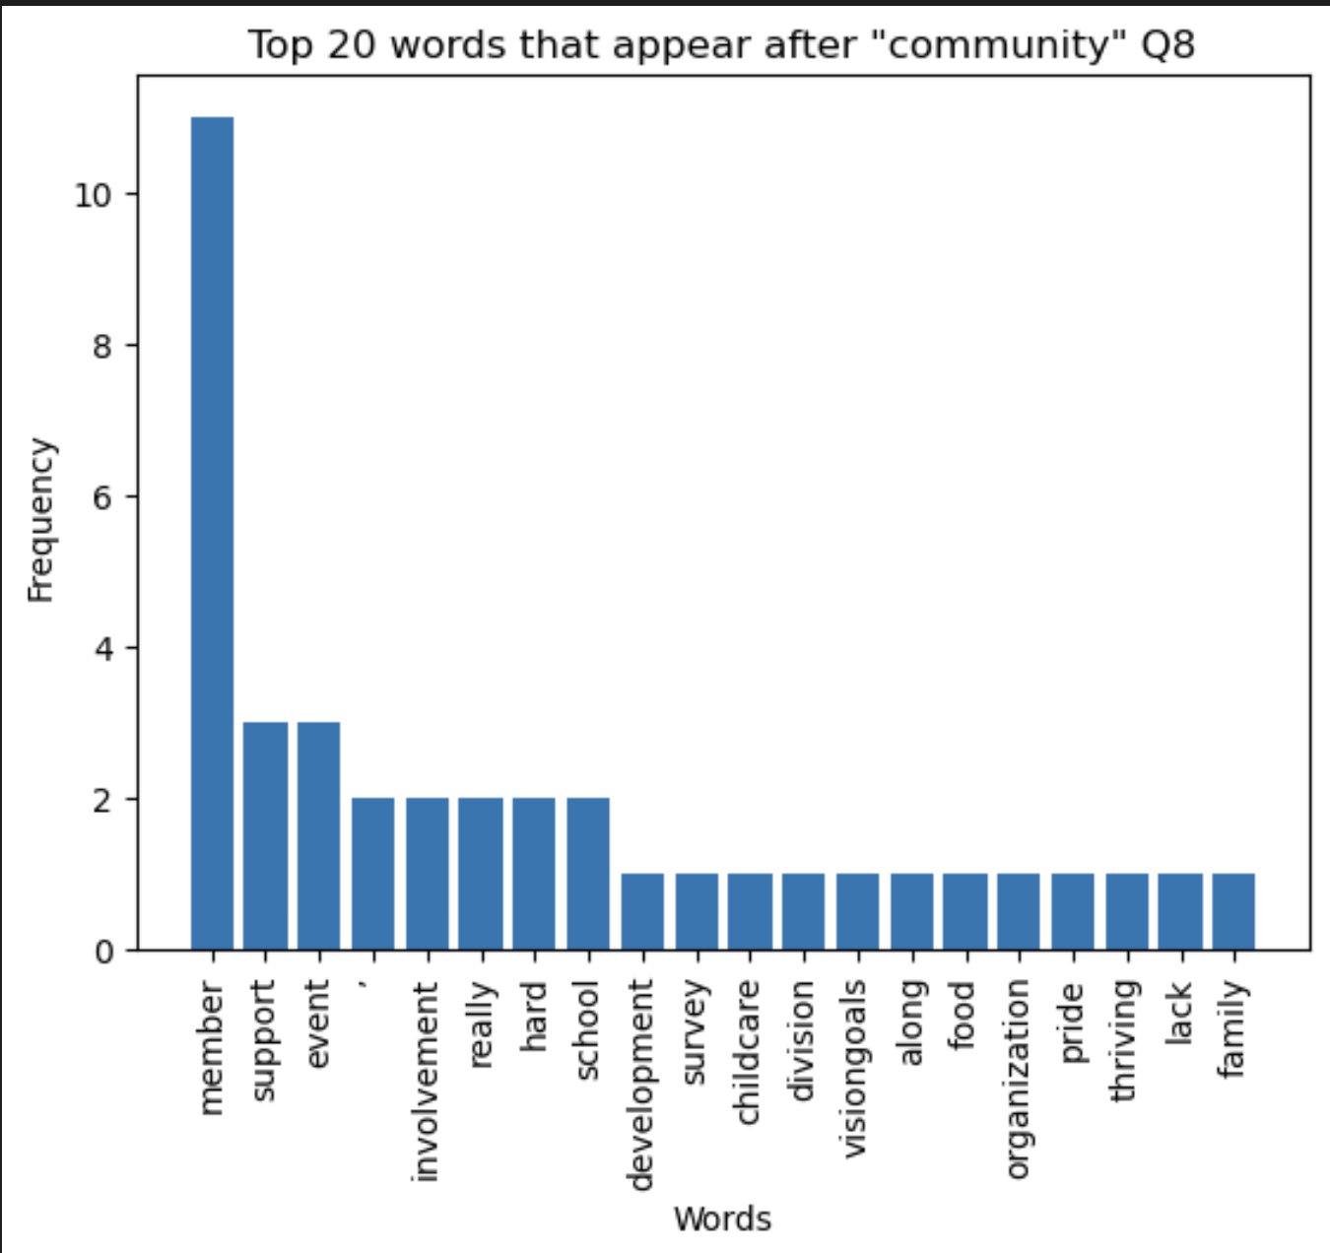

Slide 13
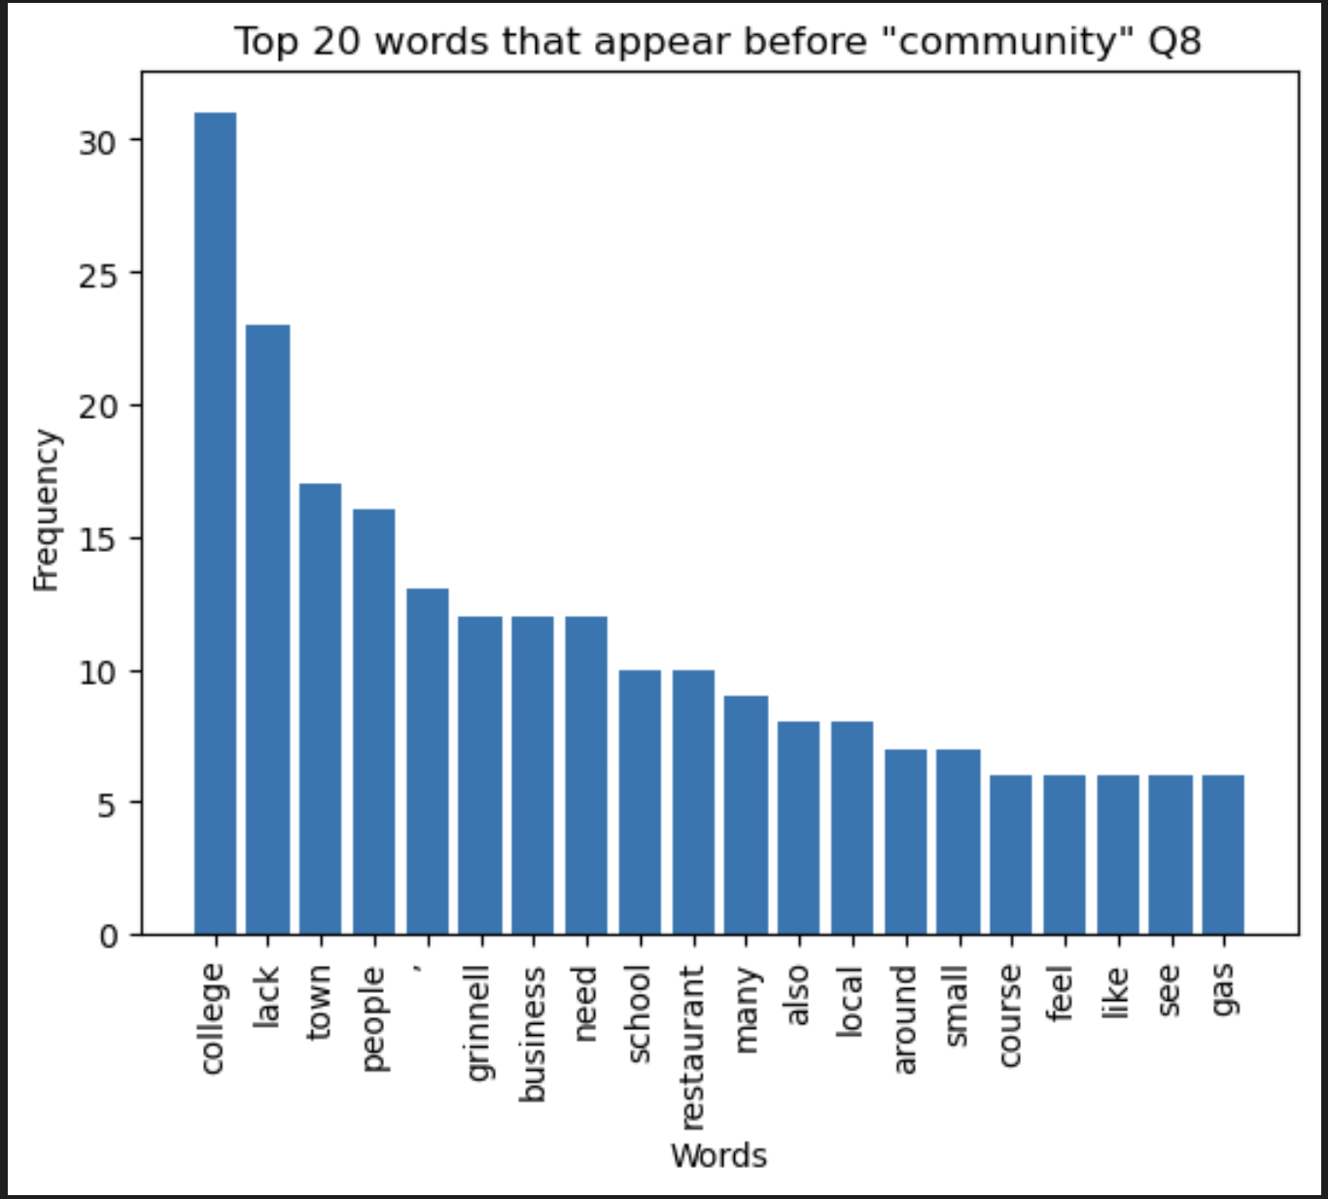

Slide 14
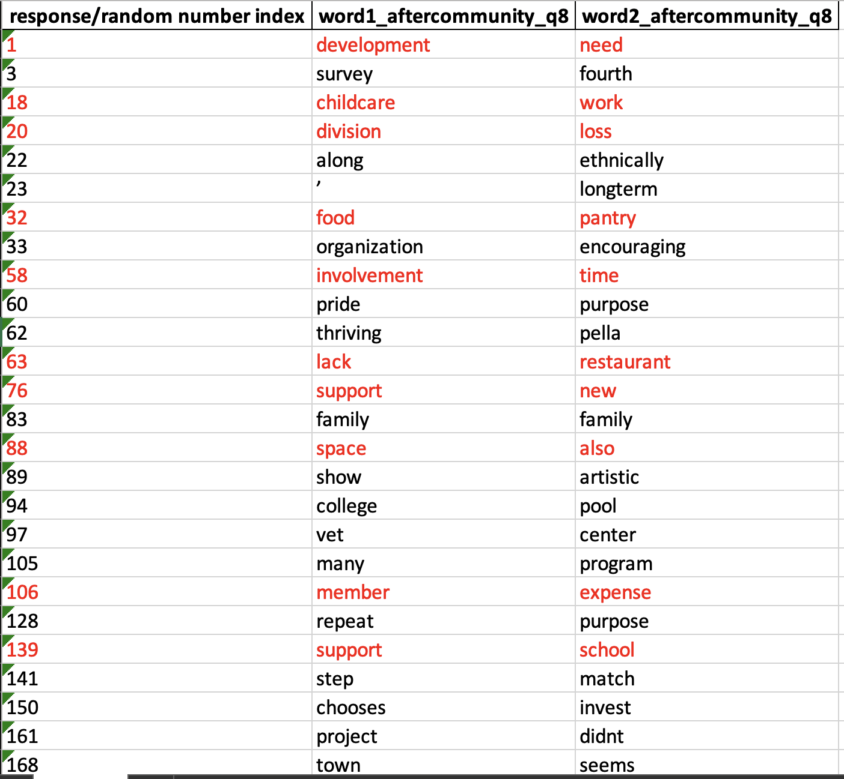

Slide 15
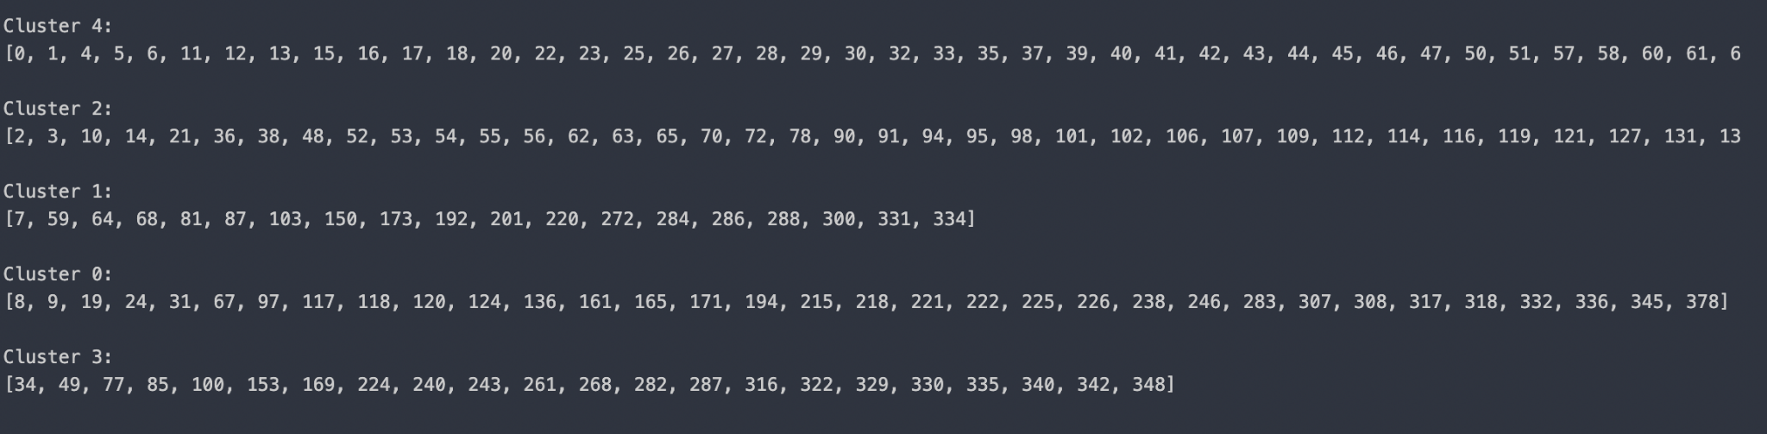
Goal #2 - Associate categories to the clusters created by k-means clustering
Create a dictionary that map cluster labels to a list of response id

Slide 16
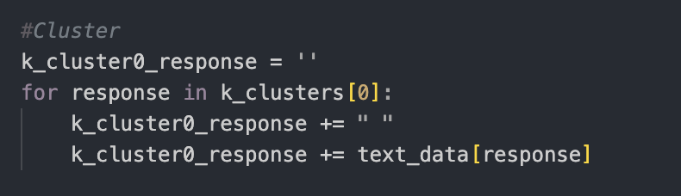

Goal #2 - Associate categories to the clusters created by k-means clustering
Join all responses in a clusters to a string
Associate the clusters to the most common noun/group of nouns mentioned

Slide 17
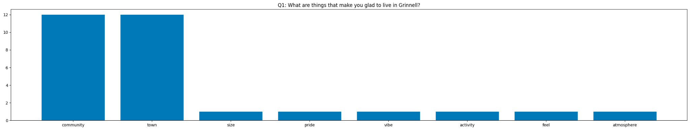
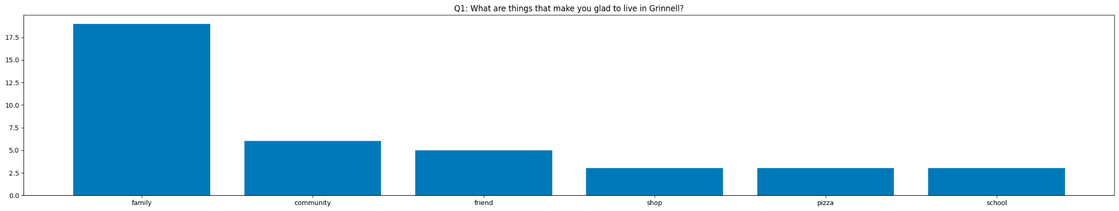
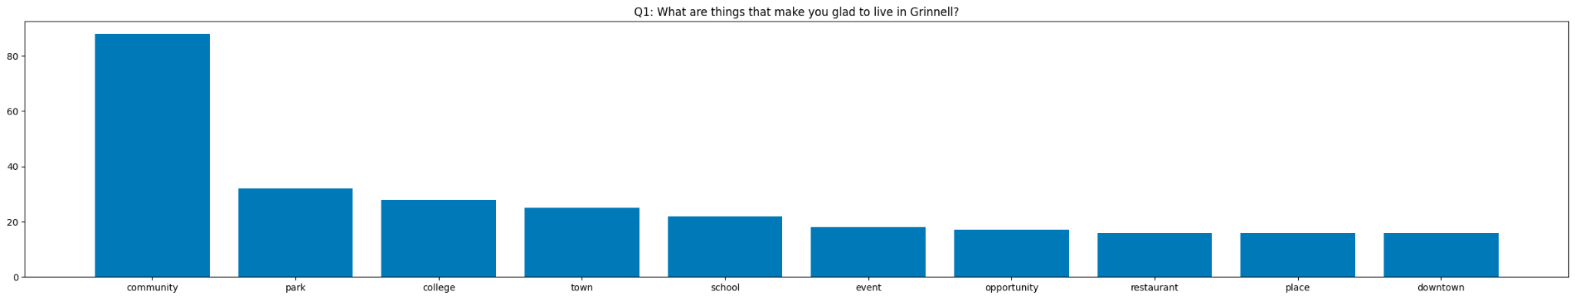
Category: Undefined based on word count due to limited number of responses
Category: family
Category: park/college/school

Slide 18
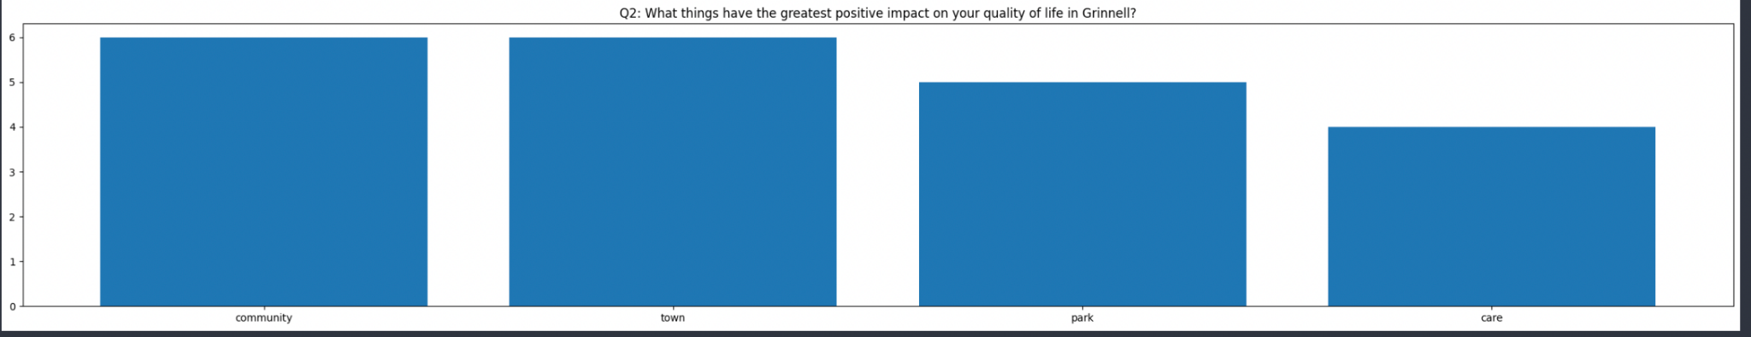
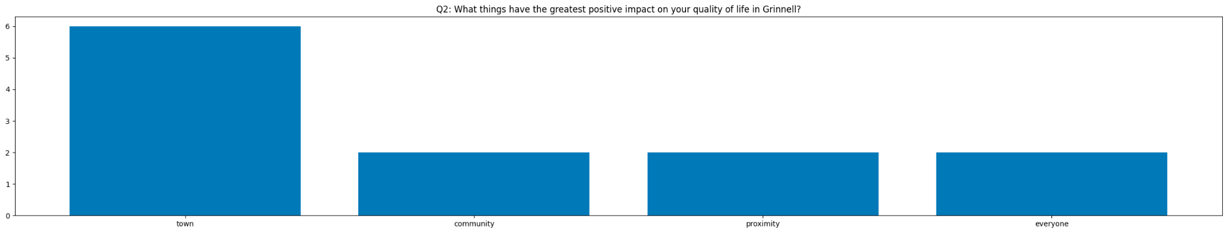

Slide 19
Goal#3 - Explore a new method of clustering - PAM clustering
What is PAM clustering?
PAM (Partitioning Around Medoids) clustering is a type of unsupervised learning technique in which we try to group similar data points together based on some similarity or distance metric.
The goal of PAM clustering is to partition a given set of data points into k clusters, where k is a pre-defined number of clusters.

Slide 20
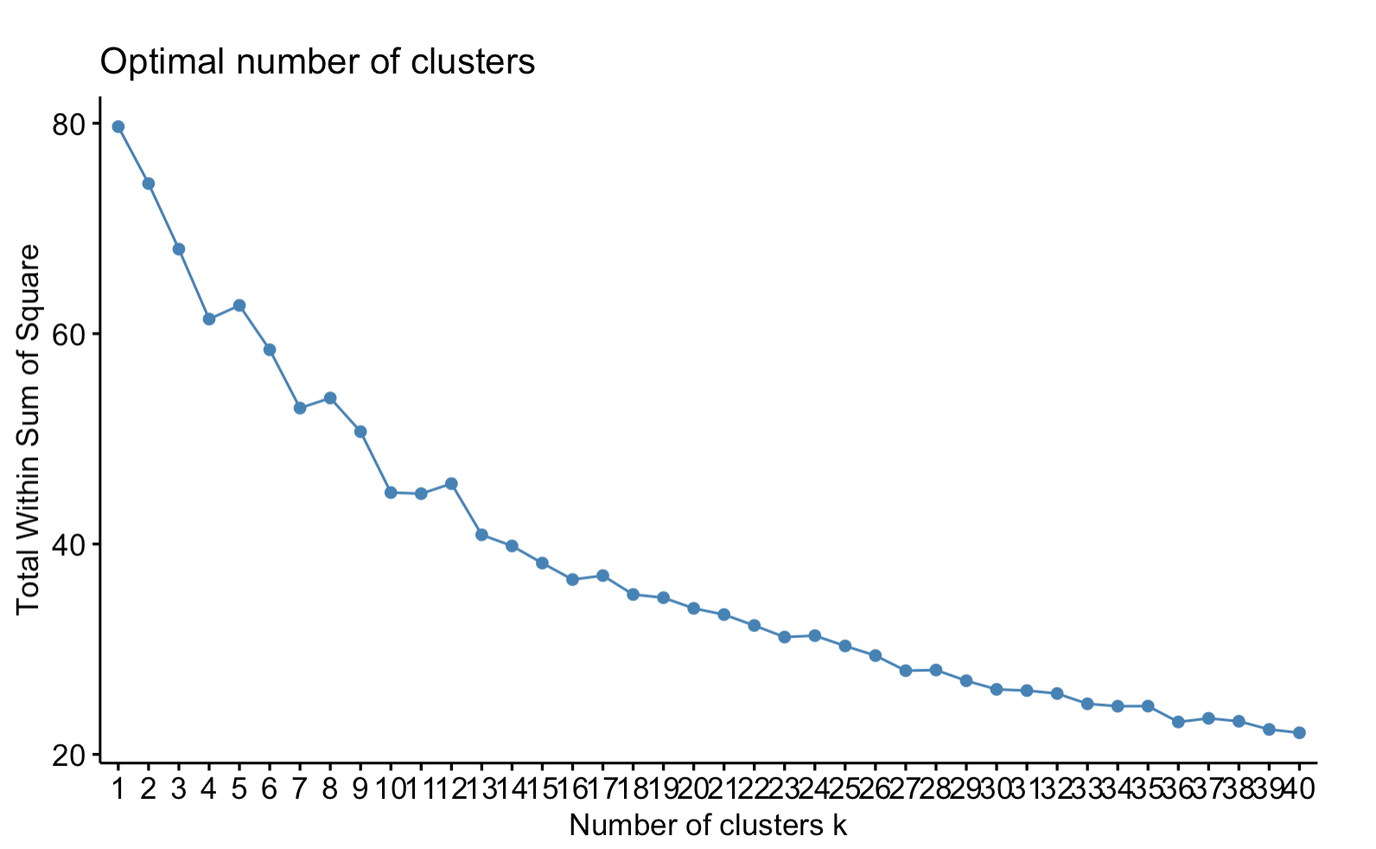
Goal#3 - Explore PAM clustering - Select K
Select k data points from dataset as the initial medoids(center).
These medoids are the representatives of each cluster. The number can be determined by the “The Elbow Method”.
The Elbow Method suggests the optimal number of clusters occurs at this plot’s “elbow”
K = 15 / 16

Slide 21
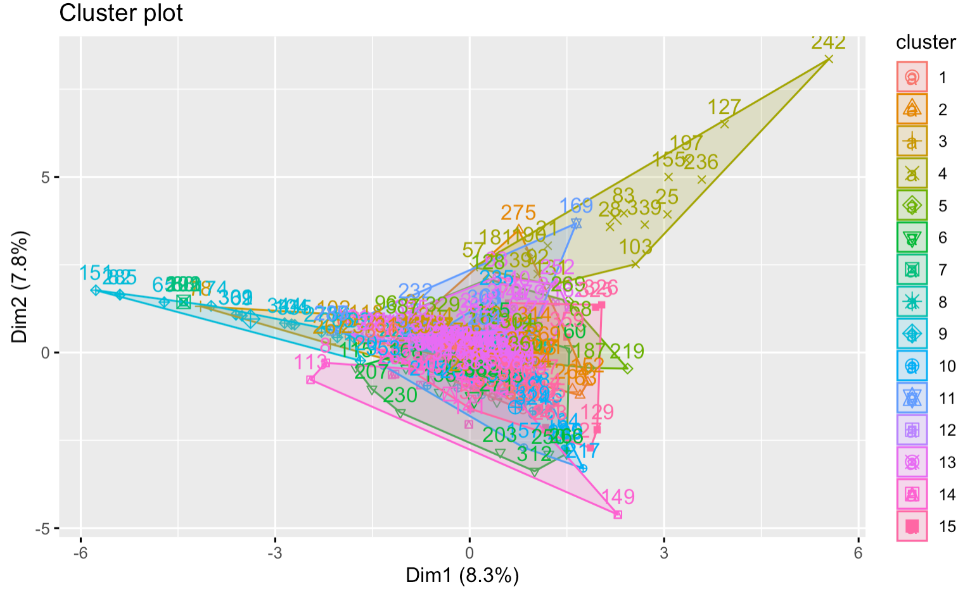
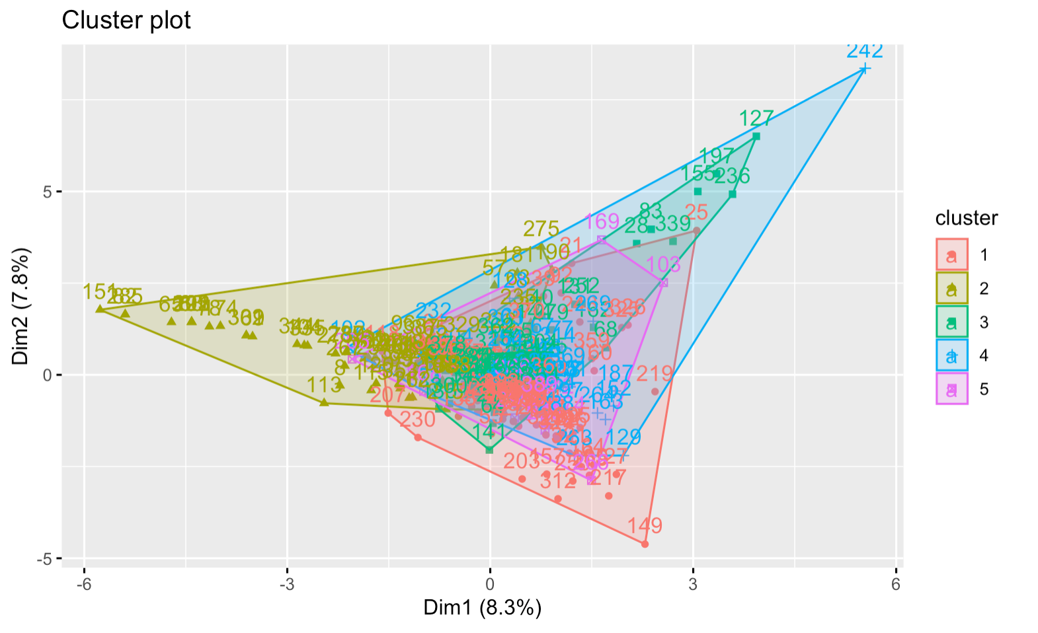
Goal#3 - Explore PAM clustering
Step 2 - PAM Clustering
K = 15
K = 5
Notes:
Too much overlap -> select k = 5 to show more distinct ; Saying same things using different words

Slide 22
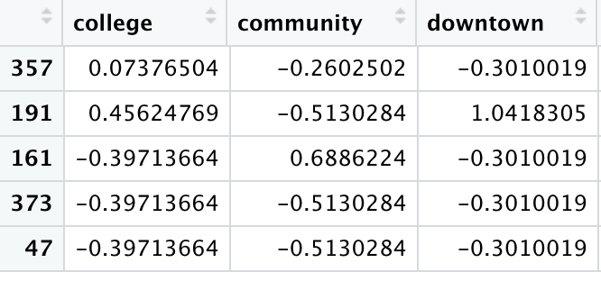
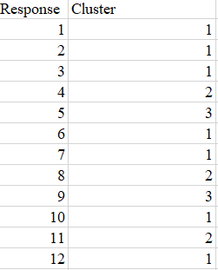
PAM clustering

Slide 23
Goal#3 - Explore PAM clustering
For example:
Response 161: Downtown park, college events, school and community music/arts programs, walkability
→ downtown, small, town
→ Safe community. General good vieb. The college.

Slide 24
Goal#3 - Explore PAM clustering
Cluster 1: downtown, small, town safe community. General good vieb. The college.
Cluster 2: community, small, town Small town. Good community.
Cluster 3: community, nice, college Nice town and college
Cluster 4: college, downtown, good, restaurants. Small beautiful downtown
Cluster 5: friends, school community, diversity, and friendships

Slide 25
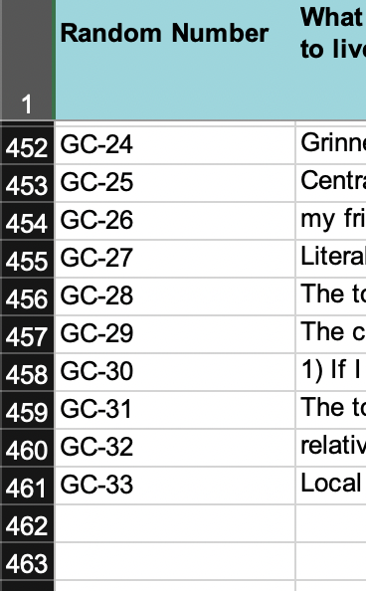
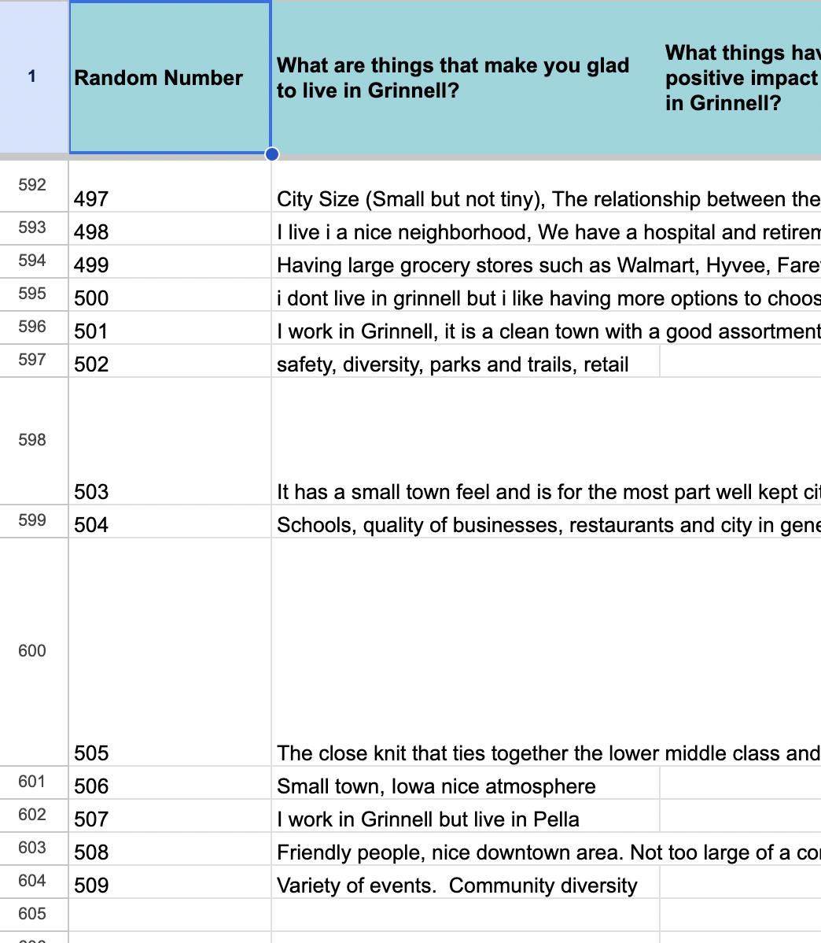
Goal#4 - Cleaning new dataset
143 observations were added to the current dataset.
Data cleaning steps were similar to the first cleaning round
New
Old

Slide 26

Reflections
Combination of words (Phrases)
Associate categories or meaningful labels to the clusters created by various clustering algorithms
Explore other methods of clustering that may work better like PAM clustering and interpret outputs
Clean new dataset

Slide 27
Moving Forwards
Make visualizations like a tree that help us see better results of the phrase involving the word lack
Expand further by identifying other useful phrases or preceding words to analyze in a similar way
Now that we have identified cluster categories/labels, look at what those people say to other question. Produce deliverable like “People Like XXX (inferred category) say Grinnell lacks XXX”
Evaluating clusters to see if clustering is actually a method that is working to create categories
Sentiment Analysis

